Slide 1

Memory Game
Steven Moses
Bryan Oliver
\

Slide 2

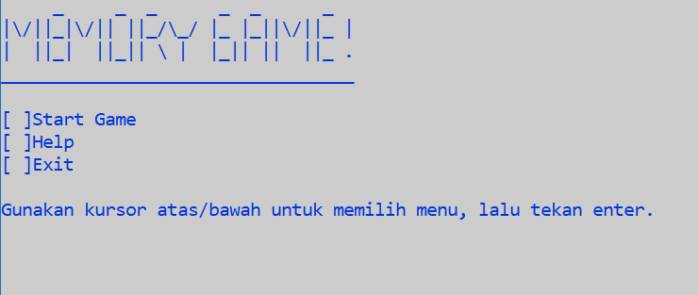
Main Menu
Main Menu

Slide 3

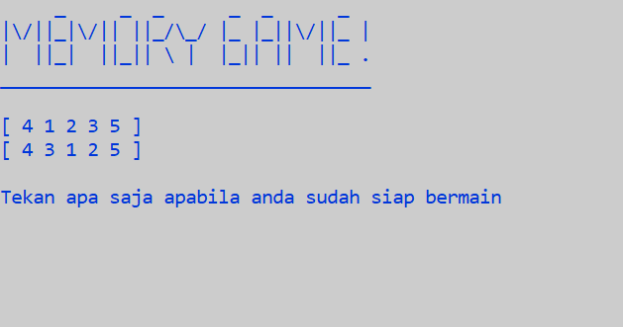
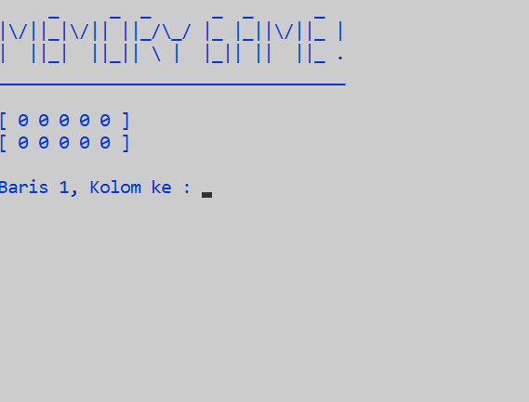
Start Menu

Slide 4
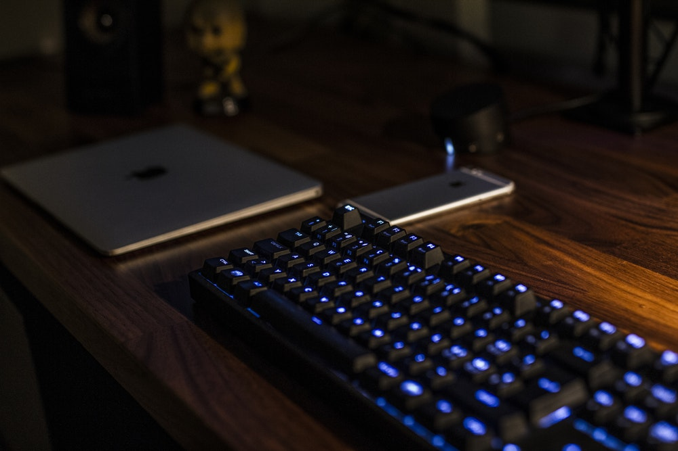
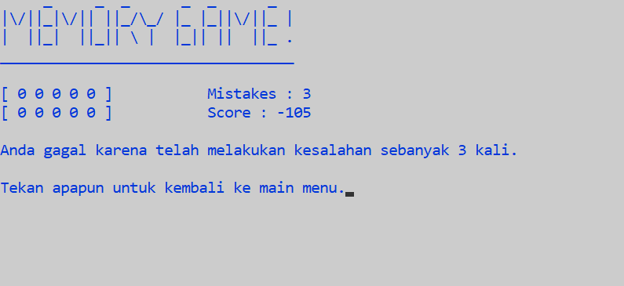
Wrong Answer
-35 pt /wrong answer

Slide 5

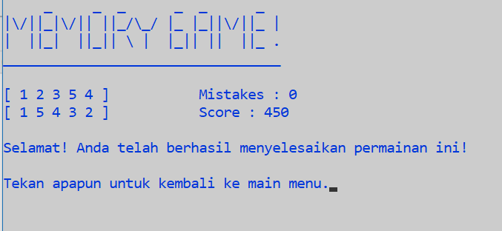
Correct Answer
Correct Answer
On Streaks
+50 pt for the first correct answer
+70 pt for the next correct answer
+90 pt for the next correct answer
+110 pt for the next correct answer
+130 pt for the next correct answer

Slide 6

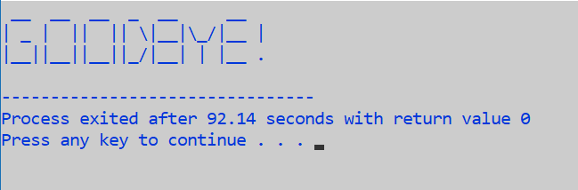
Quit Menu

Slide 7

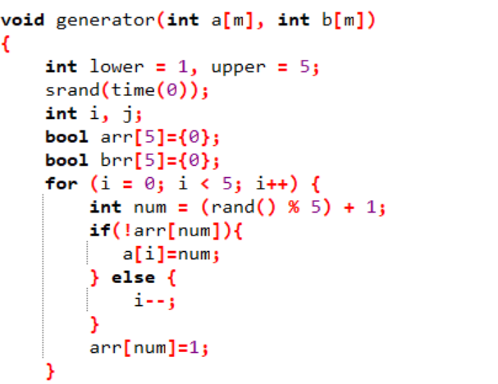
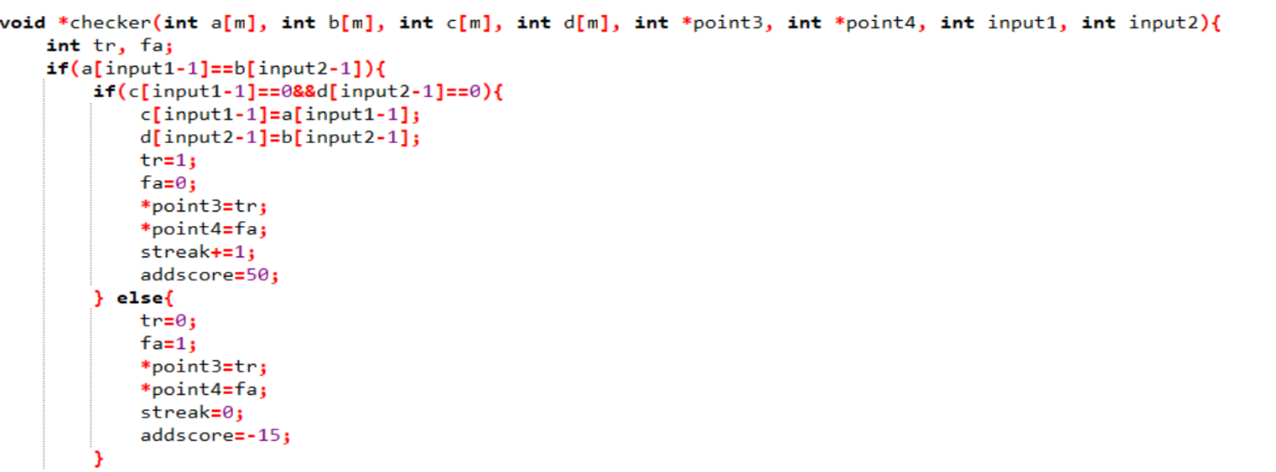
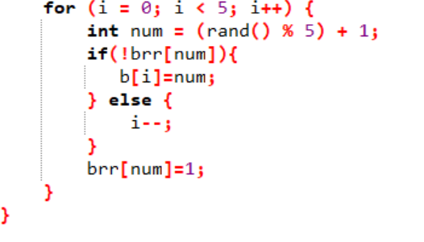
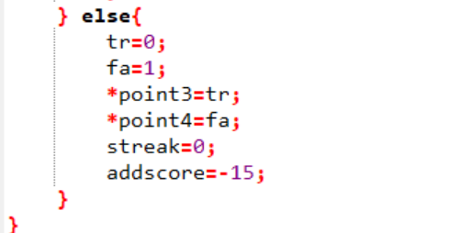
Generator And Points Code

Slide 8

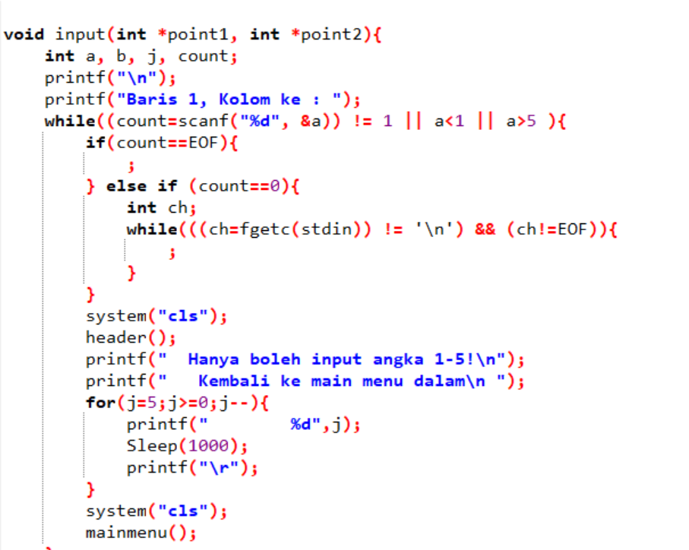
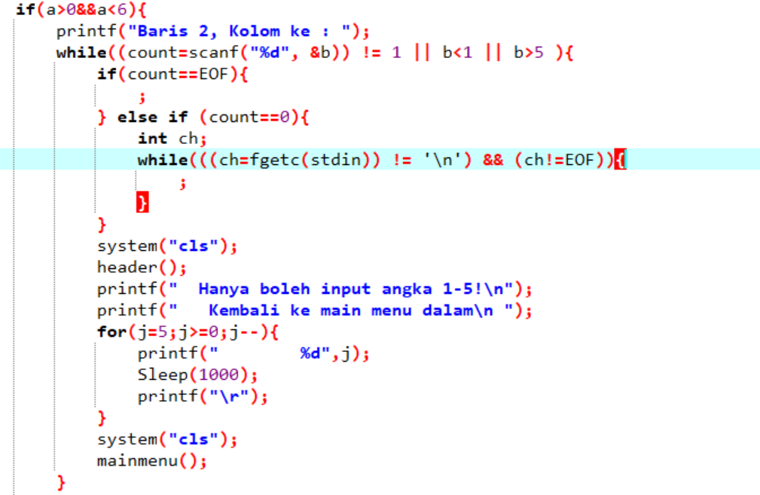
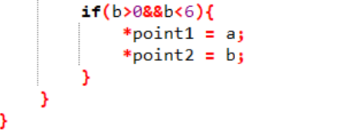
Start Menu
Input Code

Slide 9
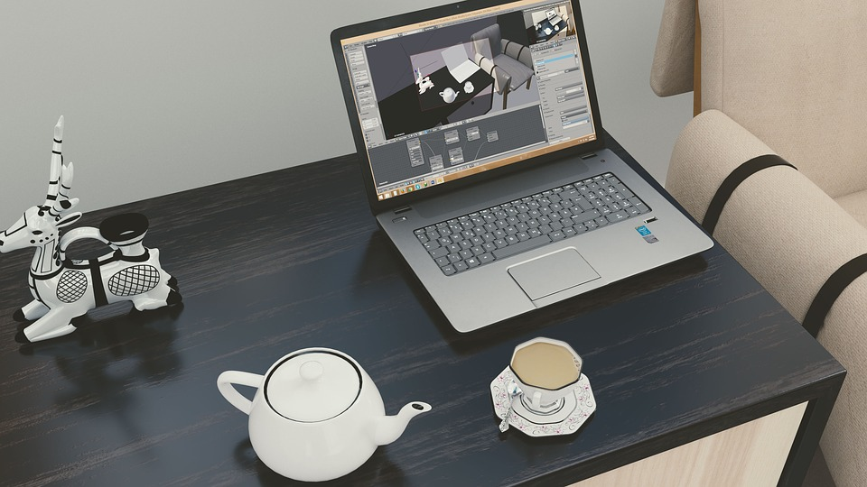
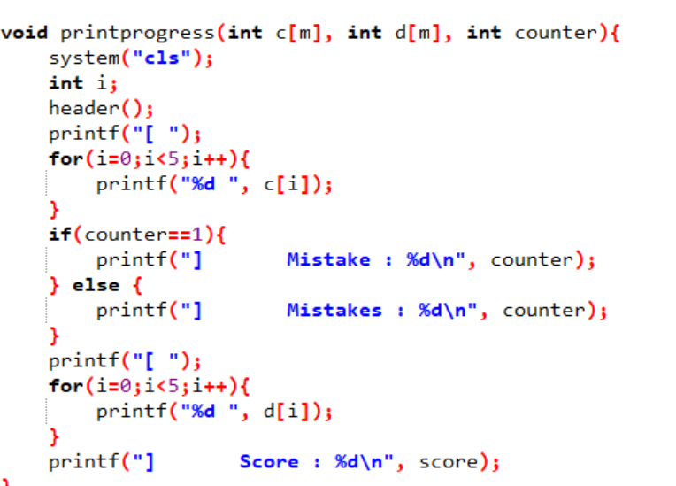
Help Menu
Print Progress

Slide 10

THANK YOU

